Slide 1
Paper Summarization
Presented by Liu Rentao
Student Number: 22060452
Mail: woshizhansen@gmail.com

Slide 2
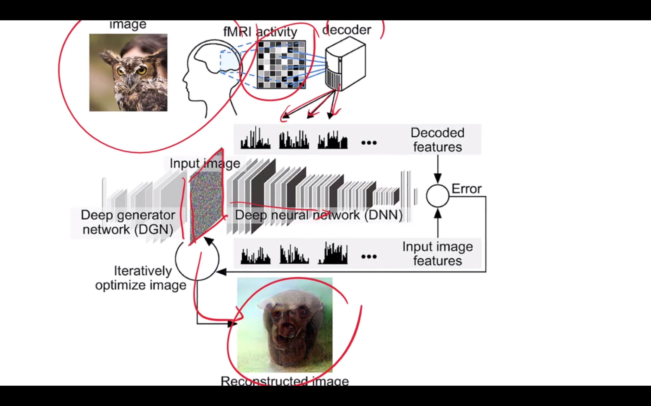
Deep image reconstruction from human brain activity
Have a look at a picture, then detect the fMRI value as the feature input of reconstruct neural network.

Slide 3
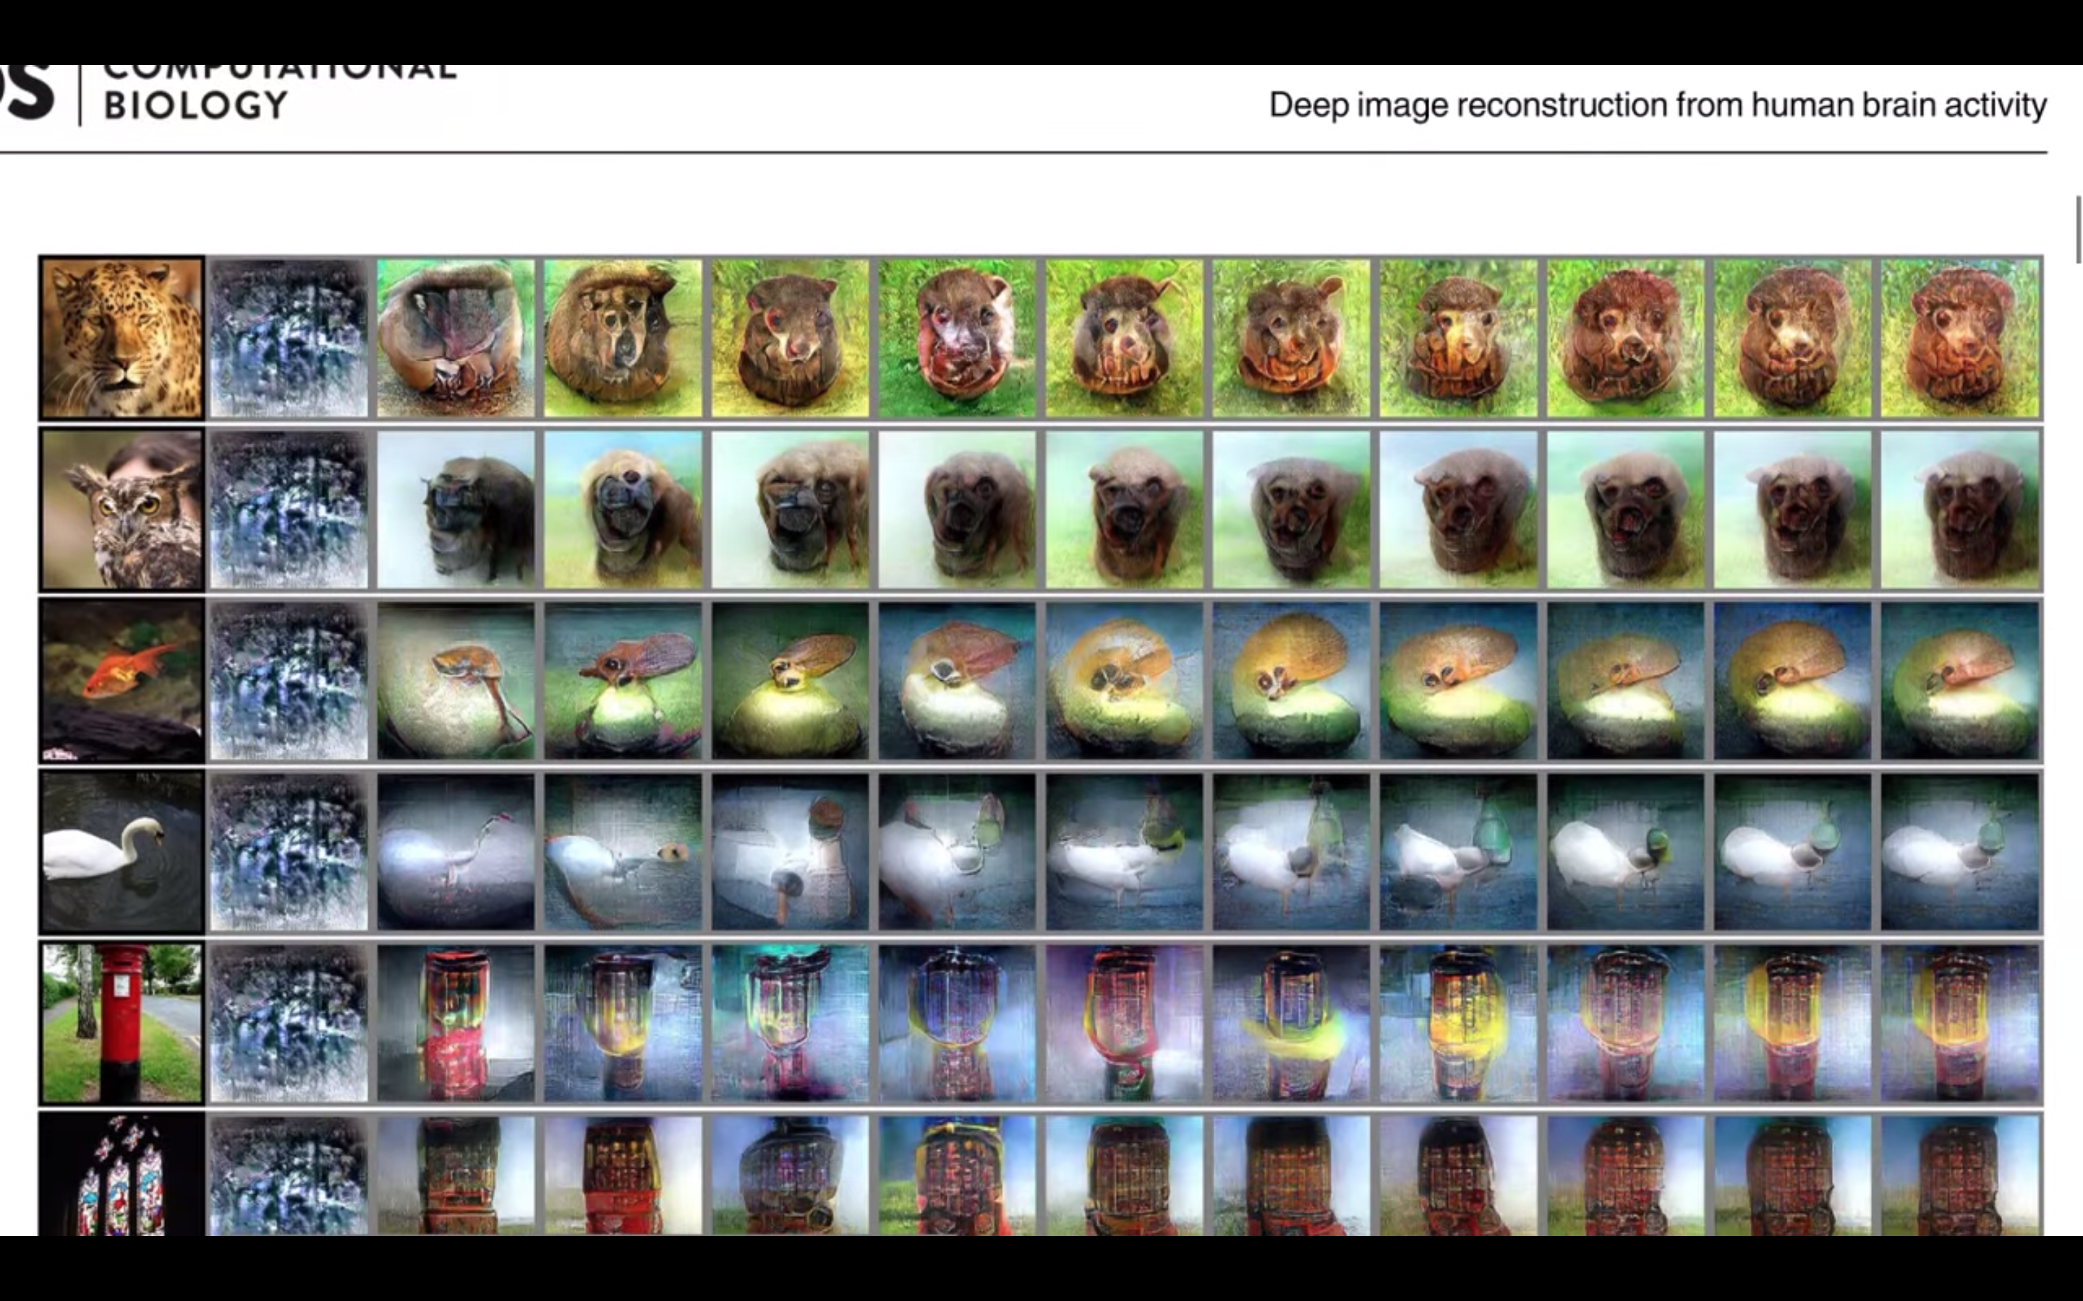
Contour Judgement is ok.
Although the final reconstructed picture is not much like the original pic. People can still recognize its profile.

Slide 4
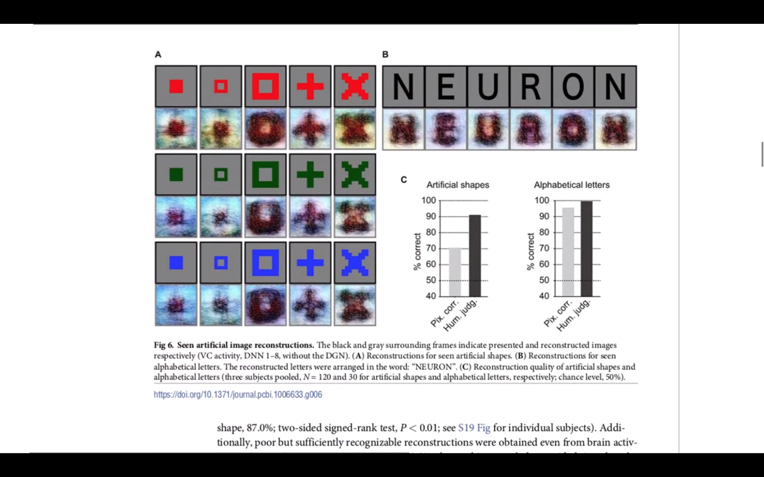
When original pic comes to simpler ones
When input

